Slide 1
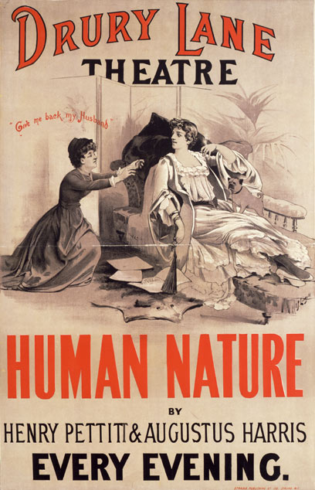
IB THEATRE
Yeah.

Slide 2
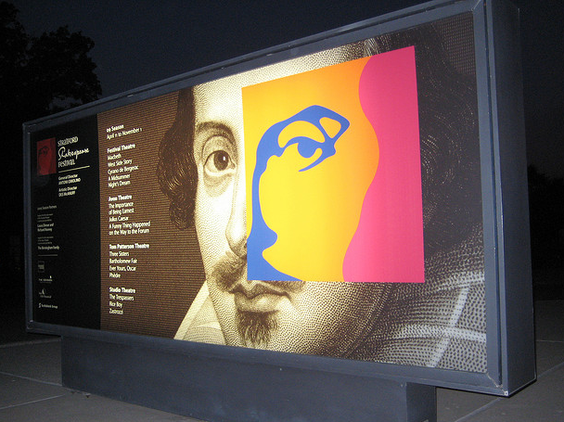
What
Is
the
PURPOSE
Of THEATRE?

Slide 3
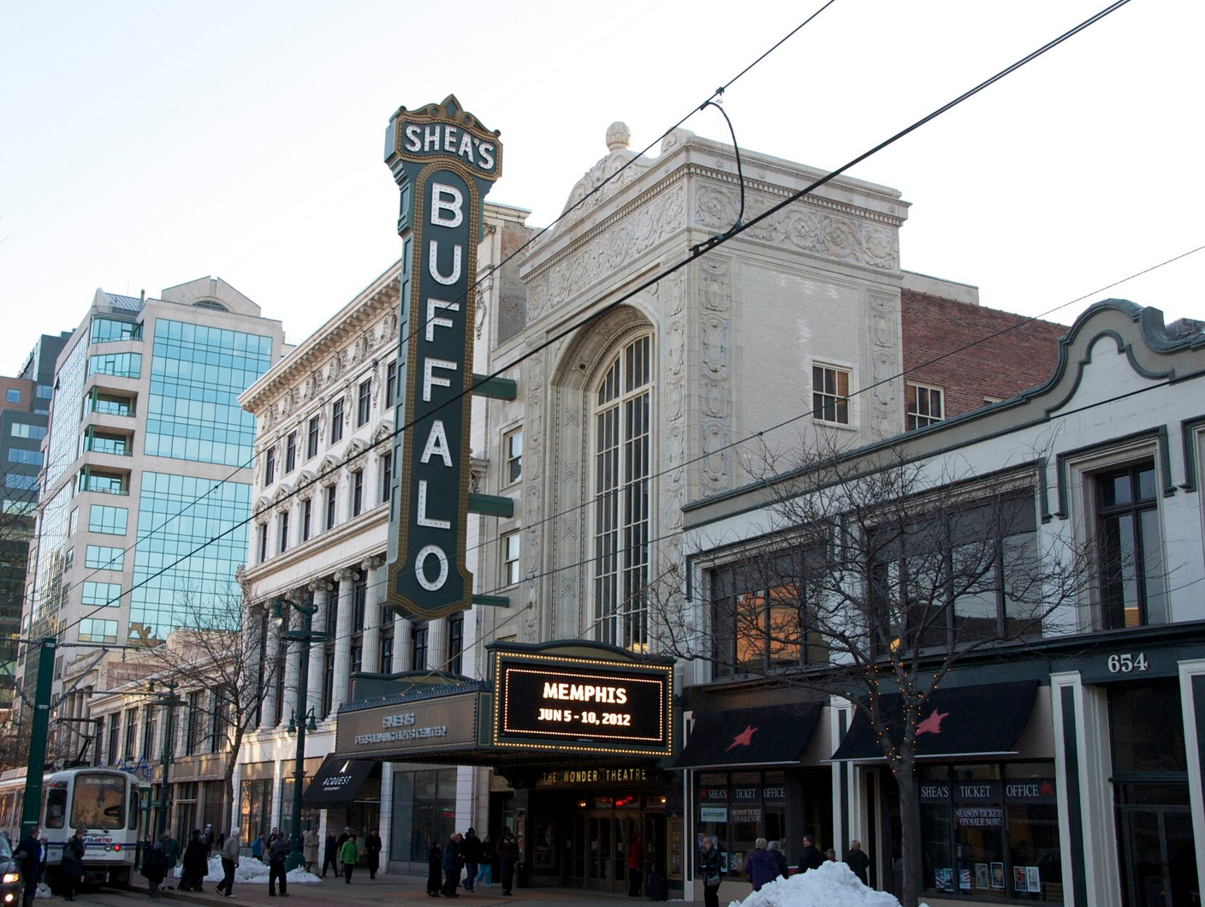
What is theatre, exactly?

Slide 4
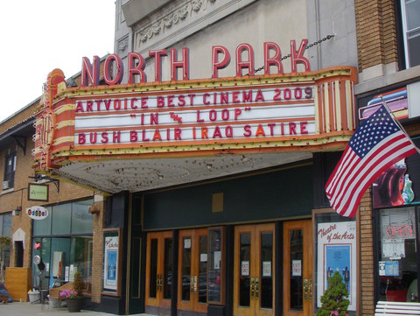
How is it different from The other arts?

Slide 5
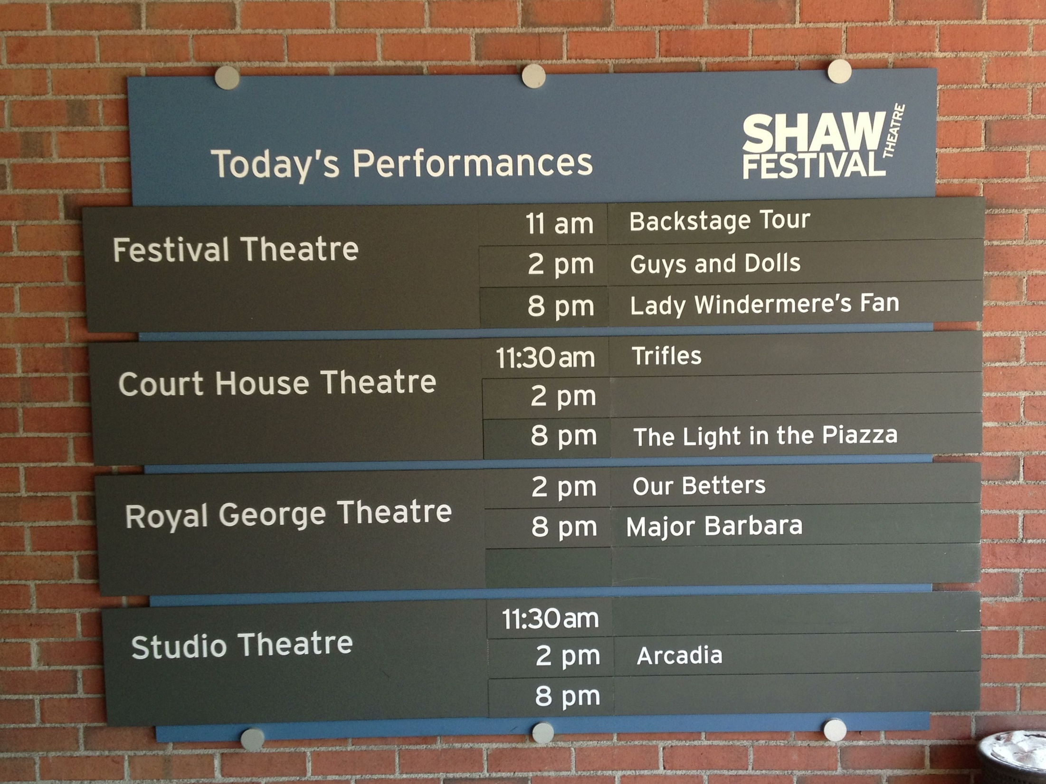
What does it have to do with me?
What does it have to do with me?
What does it have to do with me?
What does it have to do with me?

Slide 6
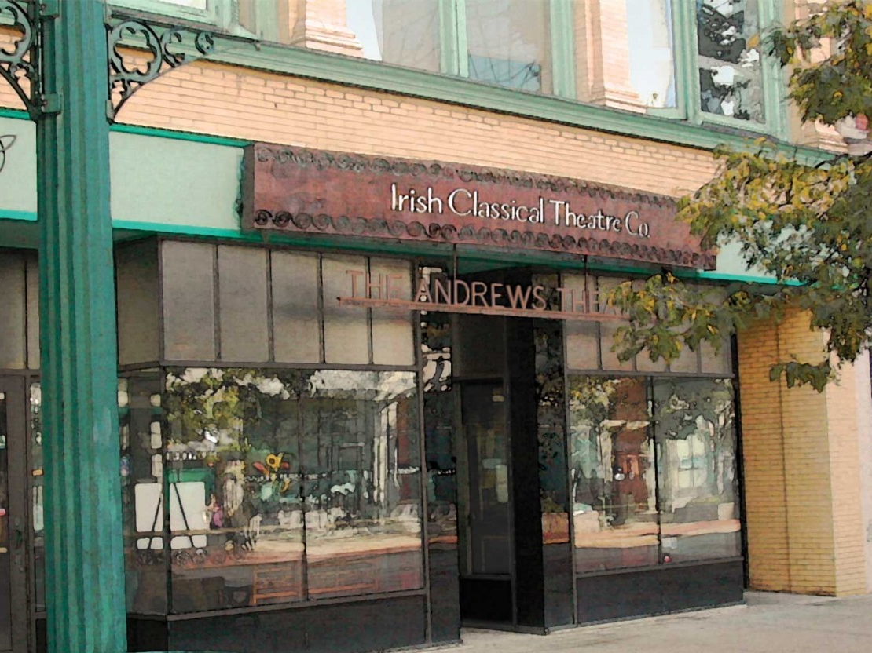

Slide 7
How am I going to use it?

Slide 8
Image Citations
Stratford Festival: http://farm3.staticflickr.com/2610/3829438840_39185e1fa9_z.jpg
North Park Theater: http://cinematreasures.org/theaters/5791
Shea’s Theater: http://usnavyband.blogspot.com/2011_03_01_archive.html
Shaw Festival: realisticcookingideas.com
Irish Classical Theatre: http://www.buffalotreasures.com/irish-classical-theatre/
Shakespeare in Delaware Park: www.yelp.com

